Slide 1

RNS Institute of Technology
(AICTE Approved, VTU Affiliated and NAAC ‘A’ Accredited)
Department of Information Science and Engineering
(Accredited by NBA for the Academic Years 2018-19, 2019-20 and 2020-21)
Data structures Laboratory-18CSL38
TRAIN TICKET RESERVATION SYSTEM
Carried out by
AYUSH KUMAR SINGH(1RN20IS031)
AYUSH RAJ(1RN20IS032)
AYUSH RAJ(1RN20IS033)
BK BINDIYA(1RN20IS034)
BHAWNA JAIN(1RN20IS035)
Staff in Charge: Dr Suresh L
Designation: Head of Department
1

Slide 2
TRAIN TICKET RESERVATION SYSTEM

Slide 3
CONTENTS:
->OBJECTIVES
->THEORY
->VISUAL REPRESENTATION OF PROJECT
->ALGORITHM
->FLOW CHART
->FURTHER ENHANCEMENTS
->CONCLUSIONS

Slide 4
Language and concepts used:
language → c.
Concepts :
Linked list – A Linked list is a collection of nodes or elements or data items.it is a linear data structure in which elements are not stored at contiguous memory locations.
here the nodes are logically connected.
The elements in a linked list are linked using pointers.
2. Structure – it is a user defined data type,used to combine dissimilar data items.

Slide 5
OBJECTIVES:
TO GIVE A STRUCTURAL
DESIGN TO RAILWAY SYSTEM.
PROVIDES FUNCTIONALITY AND FLEXIBILITY TO RAILWAY SYSTEM SUCH THAT ONE CAN OPERATE
THAT SYSTEM EASILY AND
EFFICIENTLY.
3.ALL THE MANUAL WORK SHOULD BE CONVERTED INTO COMPUTERISED SO THAT THE LOAD OF EMPLOYE SHOULD DECREASE.

Slide 6
THEORY:
Data Structure:
Singly Linked List:
IT IS A LINEAR DATA STRUCTURE WITH COLLECTION OF NODES.
HERE NODES HAVE MANY SUB PARTS BUT ONE SUB-FIELD HAS TO STORE THE ADDRESS OF NEXT OF THE NEXT NODE.

Slide 7
EXAMPLE:
STRUCT SLL
{
DATATYPE NAME1; DATATYPE NAME2;
.
.
.
STRUCT SLL *NEXT;
};
HERE,THIS IS SELF REFERENTIAL STRUCTURE i.e. STRUCTURE HAS MANY FIELDS BUT ONE OF THE MEMBER OF STRUCTURE IS POINTING TO STRUCTURE ITSELF.

Slide 8
VISUAL PRESENTATION OF PROJECT:
HERE, WE USE SIX FUNCTION:
node* create(); Void reserve(); Void cancel(); Void seat();
Void display(); Void main();

Slide 9
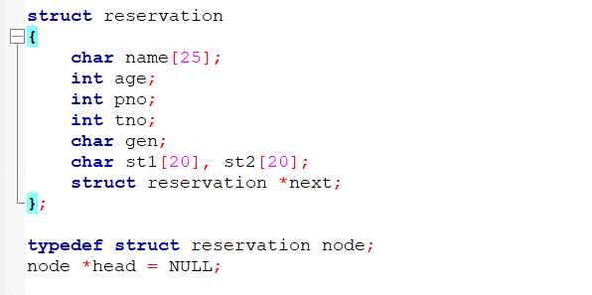
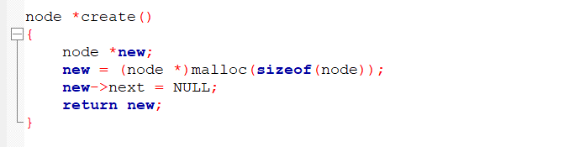
This is the structure deﬁnition:
FUNCTION FOR CREATING A NODE:

Slide 10
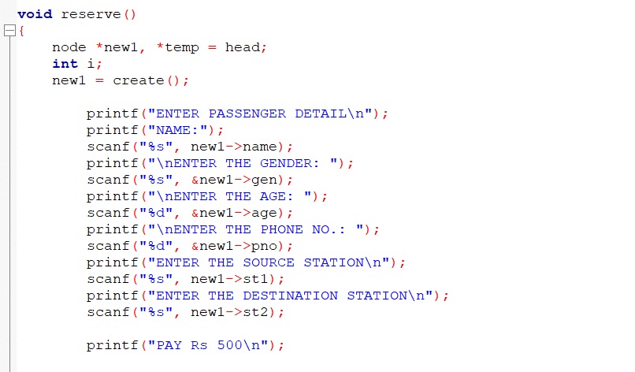
FUNCTION FOR RESERVING THE SEAT:

Slide 11
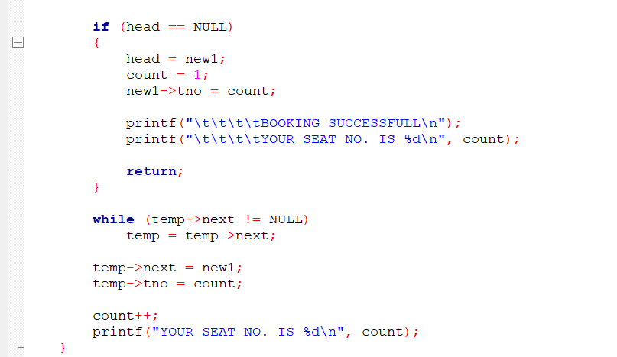

Slide 12
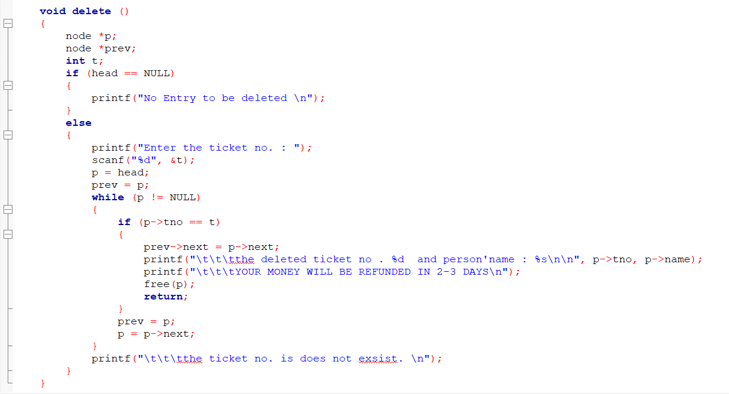
FUNCTION FOR CANCELLING THE RESERVED SEAT:

Slide 13
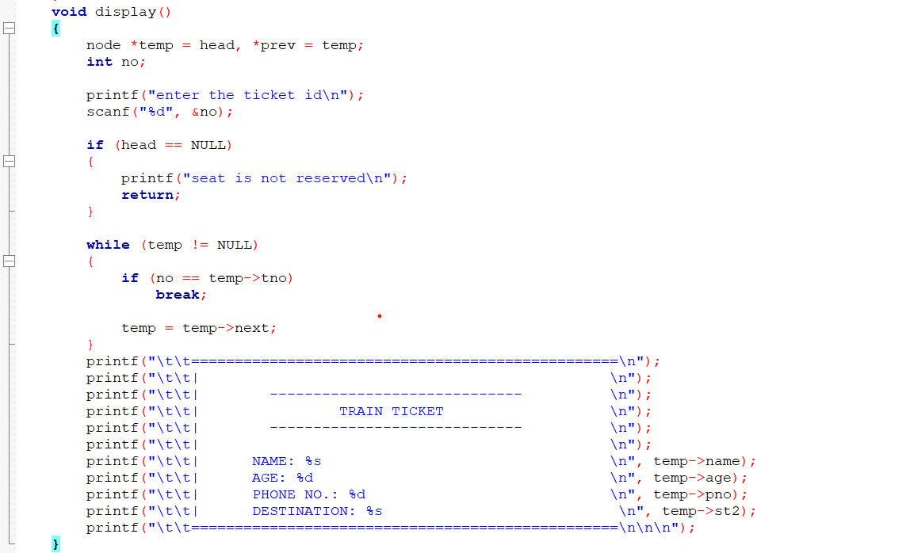
FUNCTION FOR DISPLAYING THE PASSENGERS DETAILS:

Slide 14
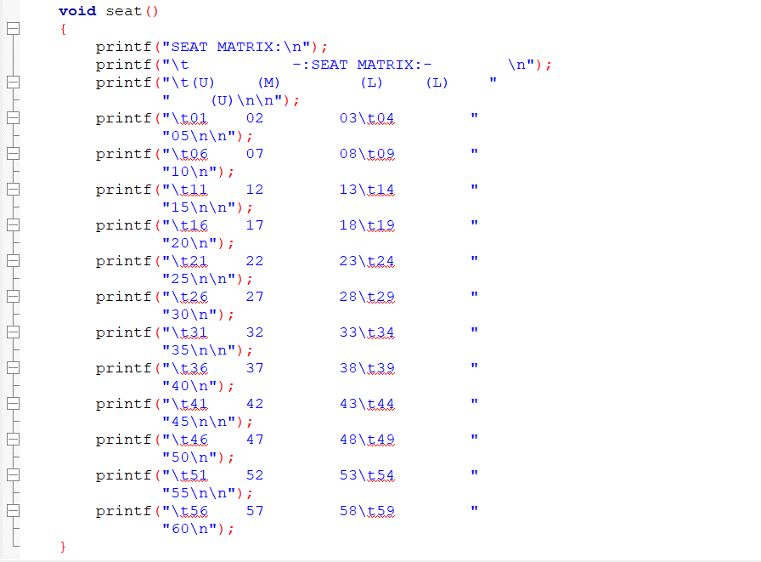
FUNCTION FOR DISPLAYING THE SEAT MATRIX OF TRAIN:

Slide 15
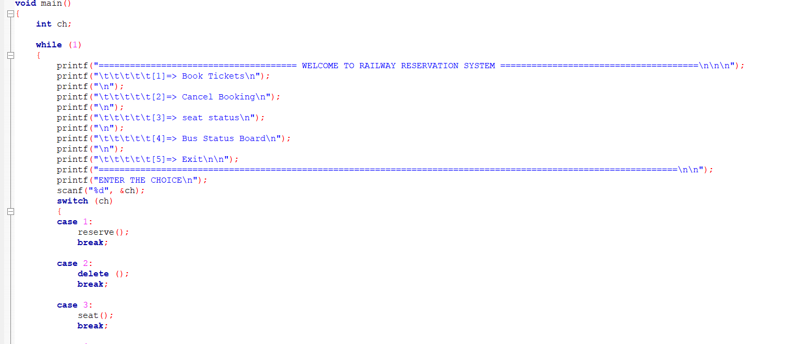
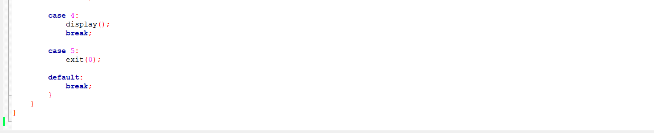
MAIN FUNCTION:

Slide 16
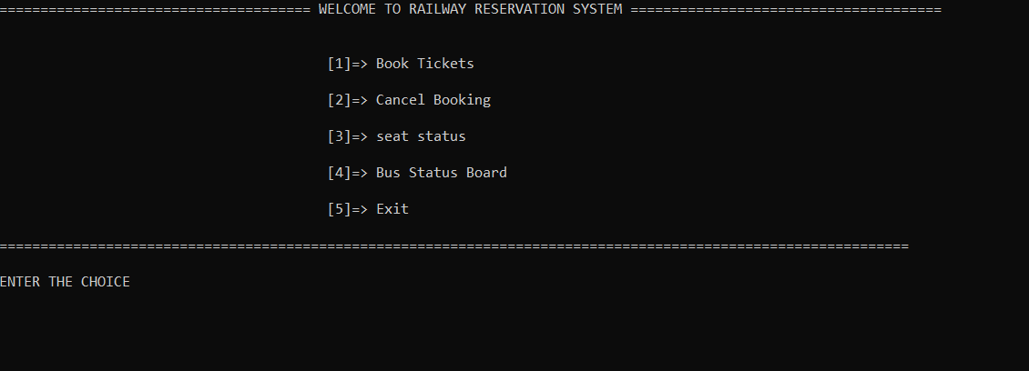
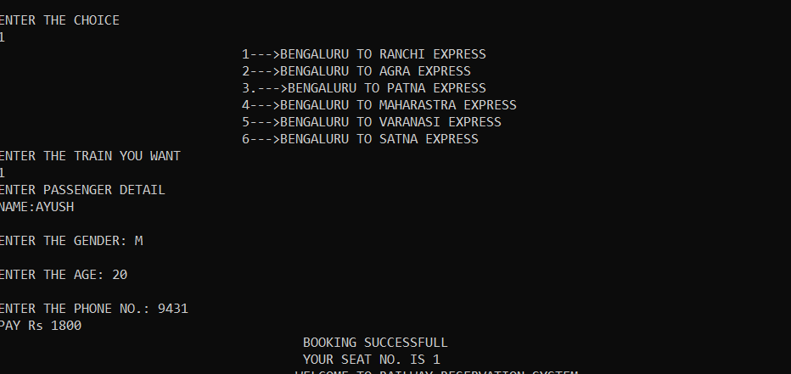
OUTPUT:
MAIN MENU:
RESERVING A SEAT:

Slide 17
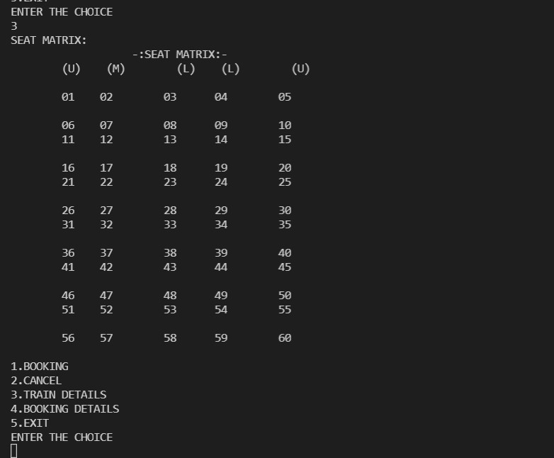
DISPLAYING THE SEAT MATRIX:

Slide 18
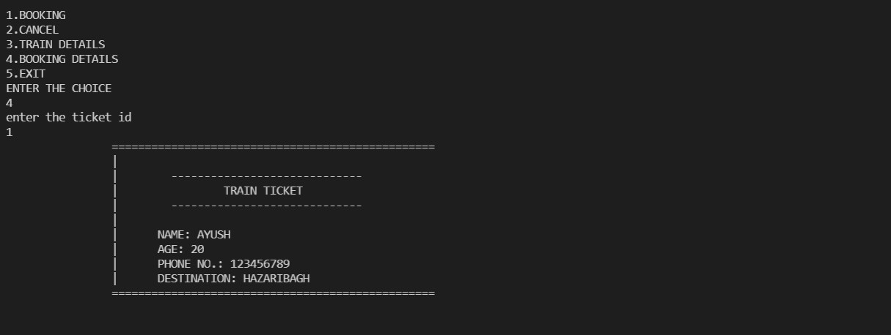
DISPLAYING THE PASSENGER DETAIL:

Slide 19
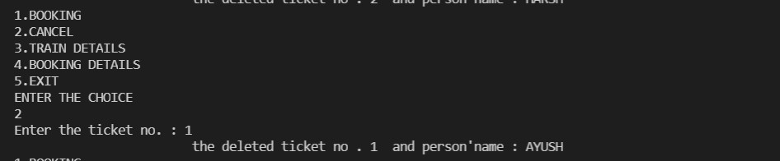
CANCELLING THE RESERVED SEAT:

Slide 20
ALGORITHM:
Step 1: Start.
Step 2: Declare Passenger details such as name,
gender , age , phone no., source station and destination station.
Step 3: Input user details, check for invalid input.
Step 4: Display ticket formed by using the above Informations and Print ticket Details.
Step 5: Store in Information & Return to main menu.
Step 6: Print the choices i.e. reserve a ticket , cancel Reservation , exit.
Step 7: End

Slide 21
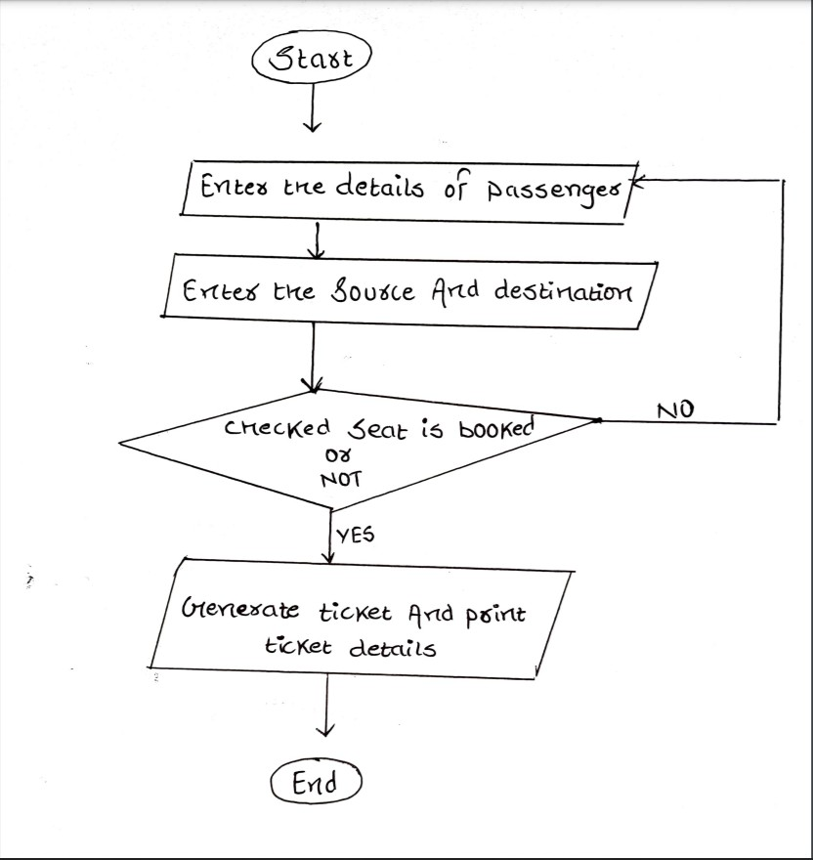
FLOW CHART:

Slide 22
FURTHER ENHANCEMENTS:
Records of client activities can be maintained.
In Future there will be a Multi login system.
Extra and user deﬁned security can be employed.
Another Enhancement would be to add more modules to cover all information off the System.

Slide 23
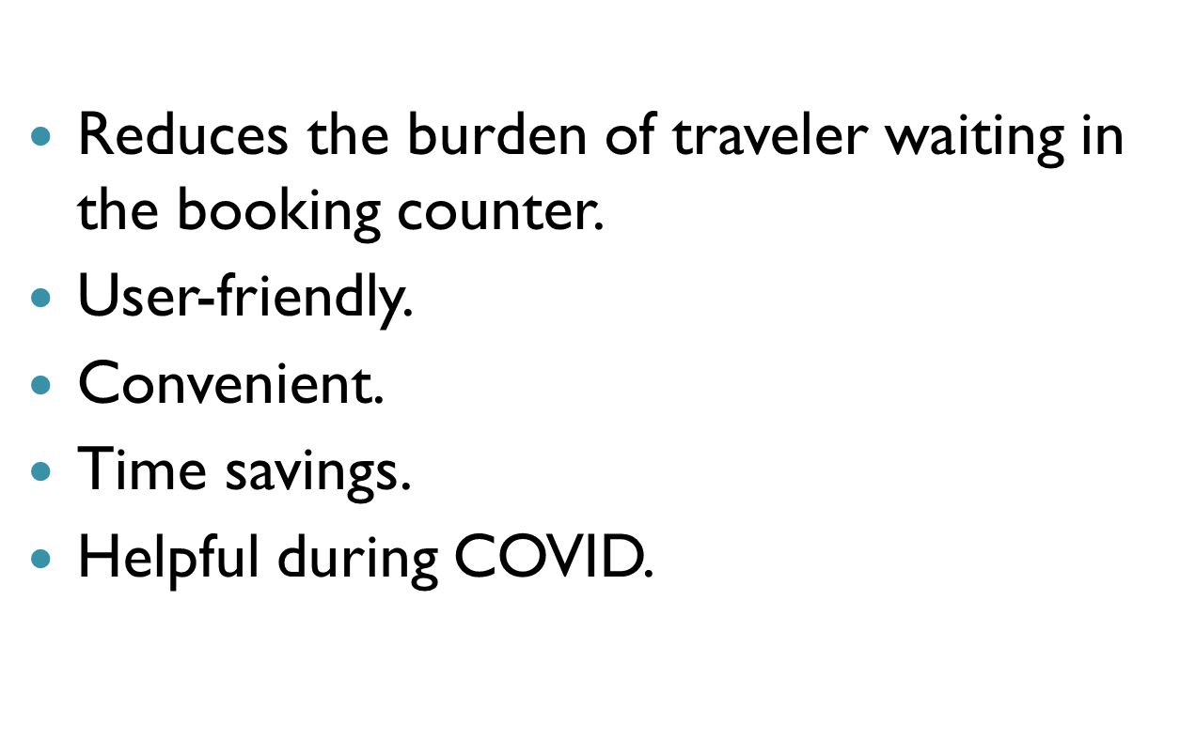
CONCLUSION:

Slide 24
THANK YOU

